Slide 1

ACME Helium-3 Lunar Mining Operations (AHLMO) Simulator Norm Evangelista

Slide 2
ACME Helium-3 Lunar Mining Operations (AHLMO) Simulator
The ACME Helium-3 Lunar Mining Operations (AHLMO) Simulator models our fully autonomous mining operations, consisting of:
autonomous mining trucks
autonomous unloading stations
AHLMO supports N mining trucks and M unloading stations that carry out mining operations over the course of a 72-hour mining "day."

Slide 3
Requirements
ID | Requirement
1 | AHLMO shall support N mining trucks (MineTrucks) and M mining unload sites (MineStations).
2 | MineTrucks will spend a random amount of time between 1 hour and 5 hours visiting a mine (MineSite).
3 | MineTrucks shall begin the simulation at a MineSite.
4 | Transit time between any MineSite and MineStation shall be 30 minutes.
5 | A MineTruck shall be assigned to the MineStation with the shortest queue.
6 | A MineStation will take 5 minutes to unload a MineTruck.
7 | A mining day shall be 72 hours long.

Slide 4
Assumptions
ID | Assumption
1 | The simulation is driven by Ticks.
2 | One Tick is defined as 5 minutes (the duration of AHLMO’s shortest operation).
3 | There are 12 Ticks in an hour. Therefore:
4 | There are 864 Ticks in a 72-hour mining day.
5 | A MineTruck spends between 12 and 60 Ticks at a MineSite.
6 | A MineTruck spends 6 Ticks in transit between MineSites and MineStations.
7 | A MineStation takes 1 Tick to unload a MineTruck.

Slide 5
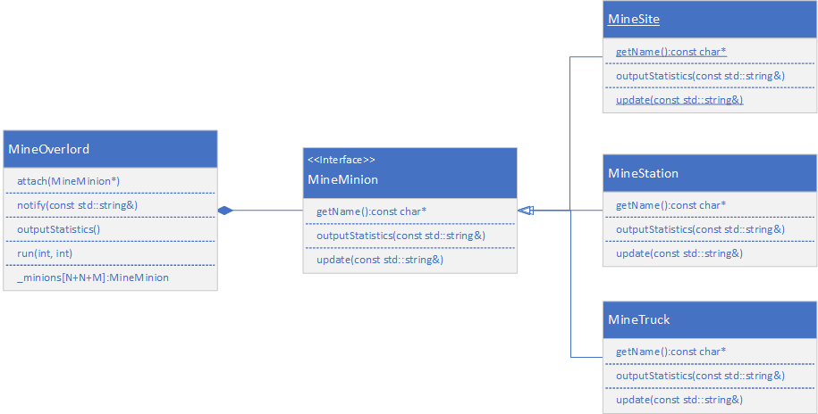
Overlord and Minions
Observer Pattern (Publish/Subscribe)
MineOverlord is the Publisher
MineMinions are MineOverlord Subscribers, and receive one Tick per update
Ticks occur every ¼ second
MineOverlord triggers statistics dump at close of mining

Slide 6
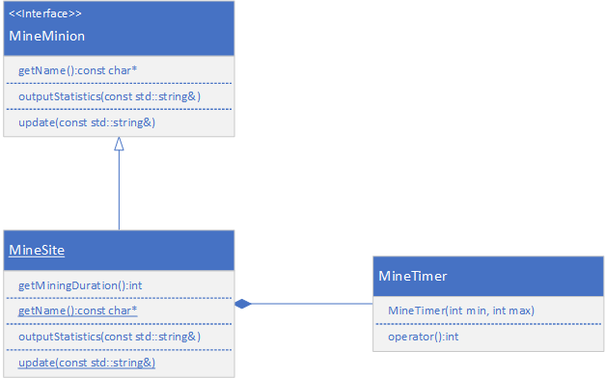
Site and Time
MineSite IS-A MineMinion
Each MineSite HAS-A MineTimer class to generate a random mining time each time a MineTruck visits
A MineSite tracks its mining and not-mining time for statistical purposes

Slide 7
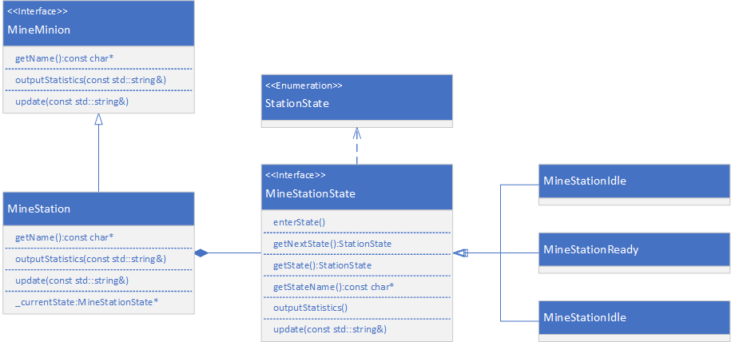
Station and States
MineStation IS-A MineMinion
MineStation HAS-A MineStationState that employs the State Pattern
IDLE state exists to factor out the idle time at the start of the simulation
Each state maintains statistics for that state

Slide 8
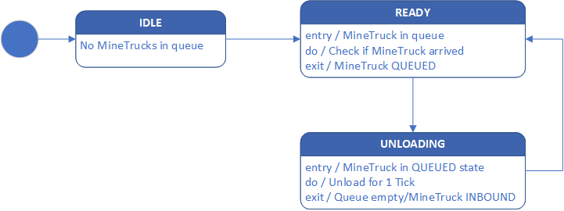
Station States
IDLE exists to factor out idle startup time
MineStations never return to IDLE state
In READY state until a MineTruck reaches the MineStation
In UNLOADING state until the MineStation queue is empty

Slide 9
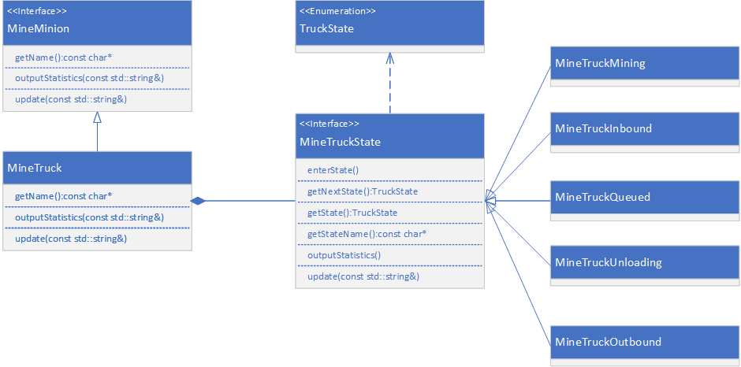
Truck and States
MineTruck IS-A MineMinion
MineTruck HAS-A MineTruck state that employs the State Pattern
MINING is the initial state
Each state maintains statistic for that state

Slide 10
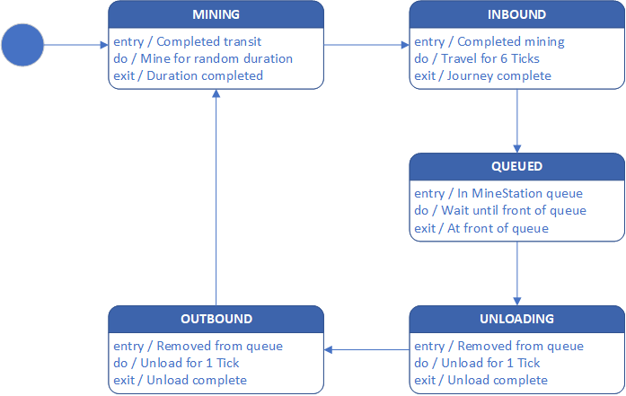
Truck States
MINING is the initial state, duration is random
INBOUND after mining is complete, for 6 Ticks; assigned to MineStation
QUEUED after inbound complete until front of queue
UNLOADING for 1 Tick
OUTBOUND for 6 Ticks
Each state maintains statistics for that state

Slide 11
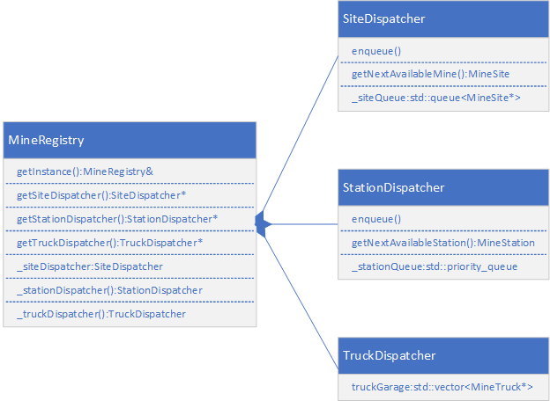
Registry
MineRegistry manages access to the dispatchers
Once a MineTruck leaves a MineSite, the MineSite is pushed onto the SiteDispatcher queue
The StationDispatcher maintains the MineStation(s) with the shortest queue at its front
The TruckDispatcher is the parking garage for all MineTrucks, ensuring their lifetime

Slide 12
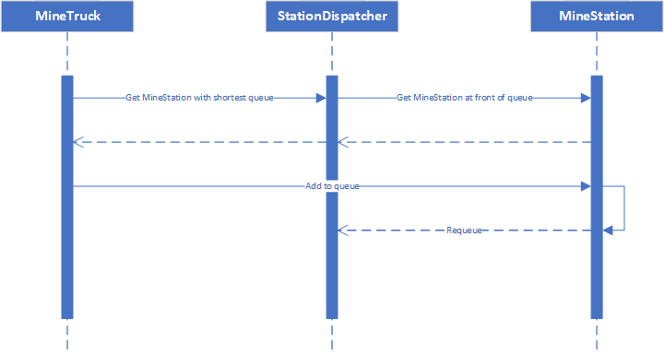
Station Dispatcher
StationDispatcher uses a min-heap to keep MineStations with shortest queues in front
Gives a MineTruck a MineStation with the shortest queue
After the MineTruck is added to the MineStation queue, the MineStation requeues itself in the StationDispatcher, rebalancing the min-heap

Slide 13
Statistics
Object | Items
MineTruck | Mining, Inbound, Queued, Unloading, Outbound times (minutes)
MineStation | Idle, Ready, Unloading times (minutes)
MineSite | Idle, Mining times (minutes)
MineTruck | Stations visited (frequency)

Slide 14
Truck state durations
30 MineTrucks, 8 MineStations
30 MineTrucks, 13 MineStations

Slide 15
Station visits per truck
30 MineTrucks, 8 MineStations
30 MineTrucks, 13 MineStations

Slide 16
“Reducing complexity and size must be the goal in every step—in system specification, design, and in detailed programming.
“A programmer's competence should be judged by the ability to find simple solutions, certainly not by productivity measured in ‘number of lines ejected per day.’”
—Niklaus Wirth, A Plea for Lean Software, IEEE Computer, February 1995

